Slide 1
5G TDD Symbol Based Resource Scheduling Interference analysis with Deterministic Pulsed Radar Signals
A MATLAB based model for understanding wireless interference in 5G systems
Eric Forbes

Slide 2
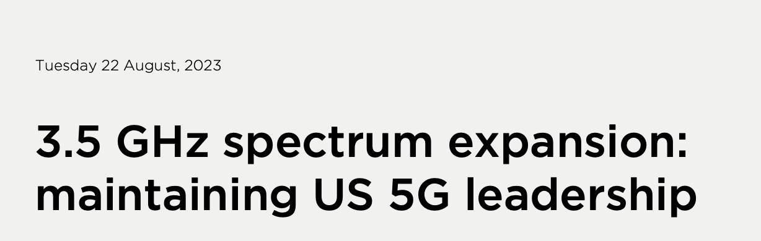
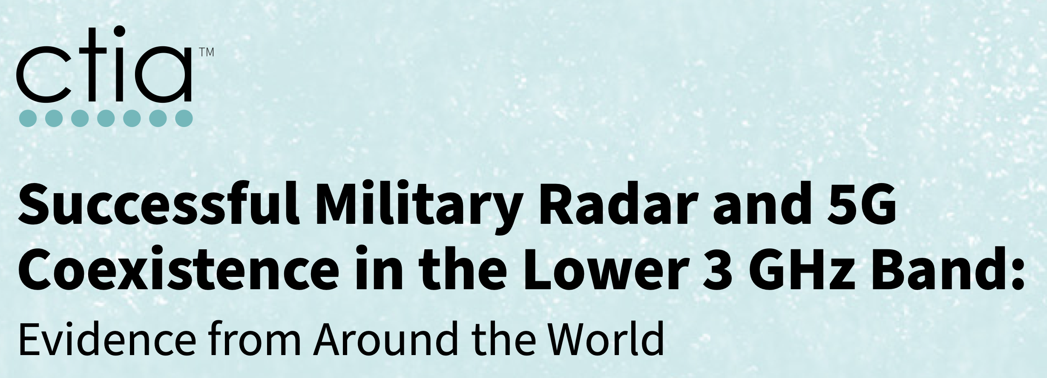
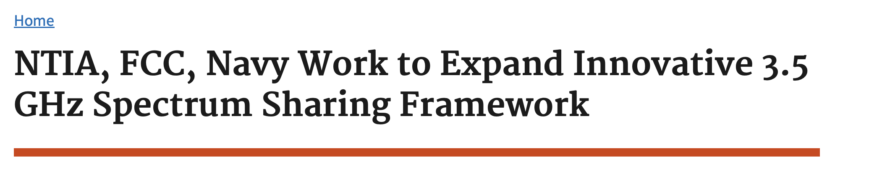
First The WHY
Spectrum is being shared!
5G is going to be used alongside military use of spectrum.
One of the most common military uses is for RADAR!

Slide 3
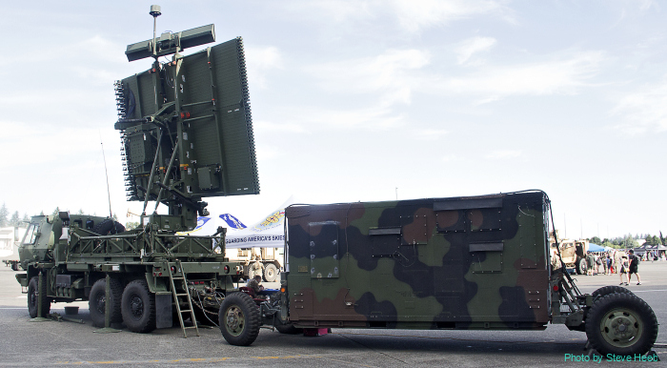
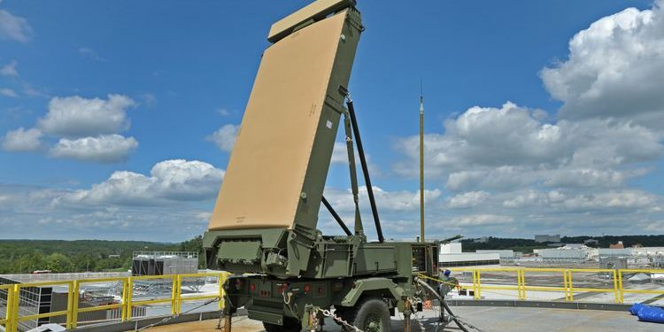
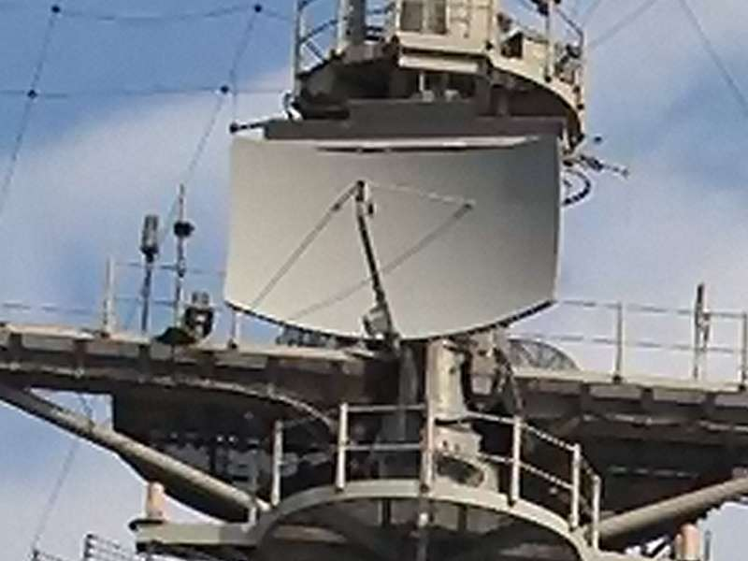
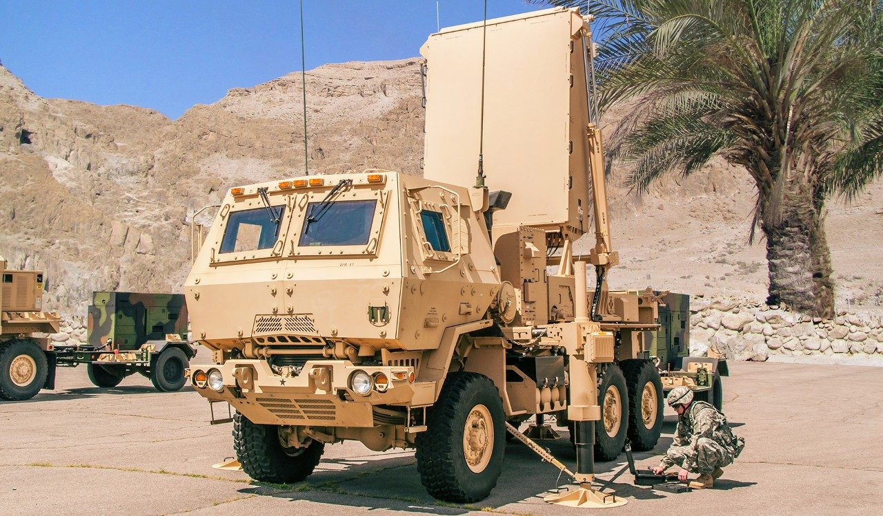
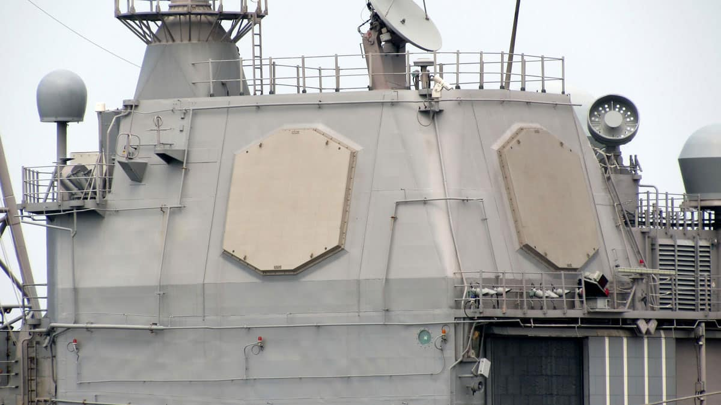
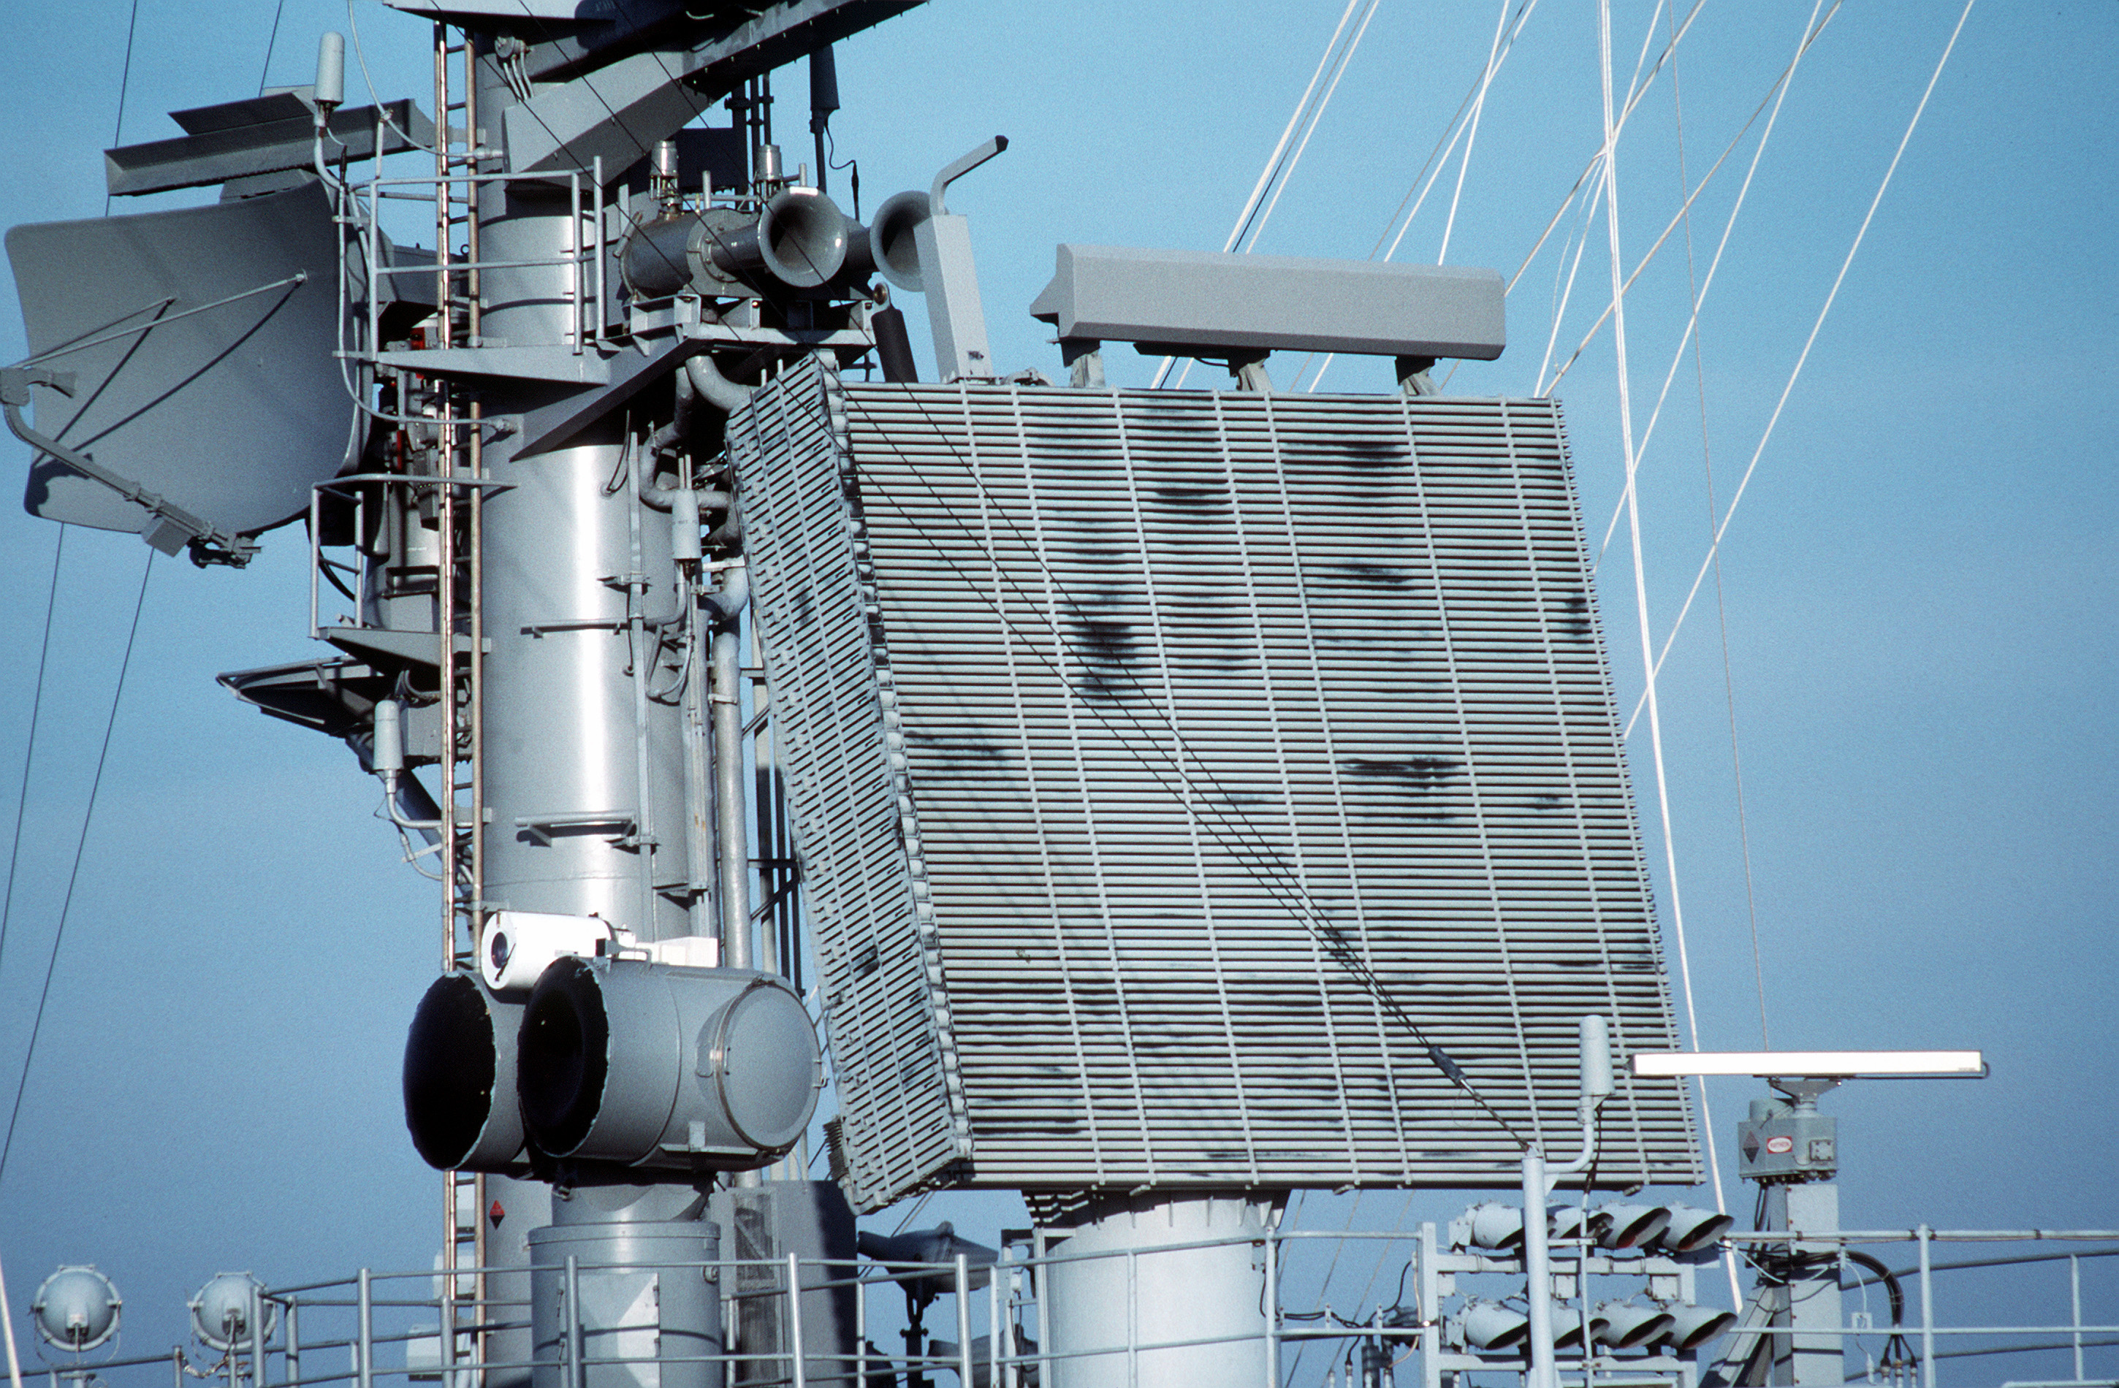
Military Use of 3.5GMHz Comes in many flavors
1. AN/TPS-75 Radar System: (U.S. Air Force)
• Function: Mobile, tactical radar system for long-range air surveillance and defense.
• Capabilities: Detects and tracks aircraft, missiles, and drones within a range of 240 nautical miles.
2. AN/TPS-80 Ground/Air Task Oriented Radar (G/ATOR): (U.S. Marine Corps)
• Function: Multi-mission radar providing air surveillance, air defense, and counter-fire target acquisition.
• Capabilities: Detects cruise missiles, unmanned aerial systems, rockets, artillery, and mortars.
3. AN/SPN-43C Air Traffic Control Radar: (U.S. Navy)
• Function: Shipboard air traffic control radar for aircraft carriers and amphibious assault ships.
• Capabilities: Provides aircraft control during launch and recovery operations.
4. AN/TPQ-53 Counterfire Target Acquisition Radar: (U.S. Army)
• Function: Mobile radar system for detecting and tracking incoming artillery, rockets, and mortars.
• Capabilities: Provides 360-degree surveillance and target acquisition.
5. AN/SPY-1 Radar System: (U.S. Navy)
• Function: Part of the Aegis Combat System for air and missile defense.
• Capabilities: Phased-array radar providing simultaneous air and surface search, tracking, and missile guidance.
6. AN/SPS-48E 3D Air Search Radar: (U.S. Navy)
• Function: Long-range, three-dimensional air search radar.
• Capabilities: Provides range, bearing, and elevation information for air targets.

Slide 4

How to understand what happens if both are Tx at the Same time?!
Want a model that:
Simulates a “real world 5G system”
Introduces basic radar interference
Simulates interference at the lowest levels (IQ Data)
Can show system level issues (From the 5G perspective)
Has 5G parameters that can be changed.
And more useful things we find along the way!
Scope the problem space!

Slide 5
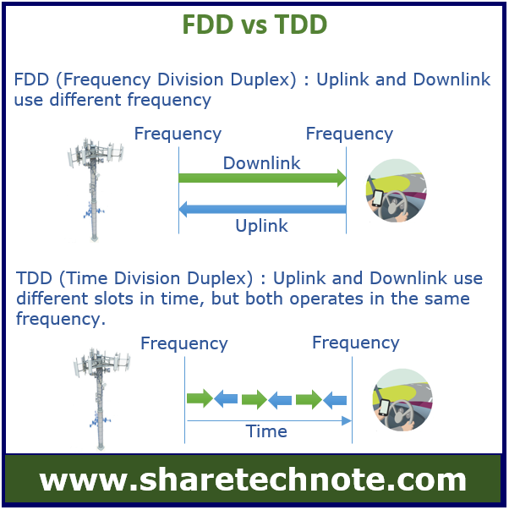
5G In the spectrum: TDD vs FDD
3.5GHz is TDD
TDD has various slot patterns

Slide 6
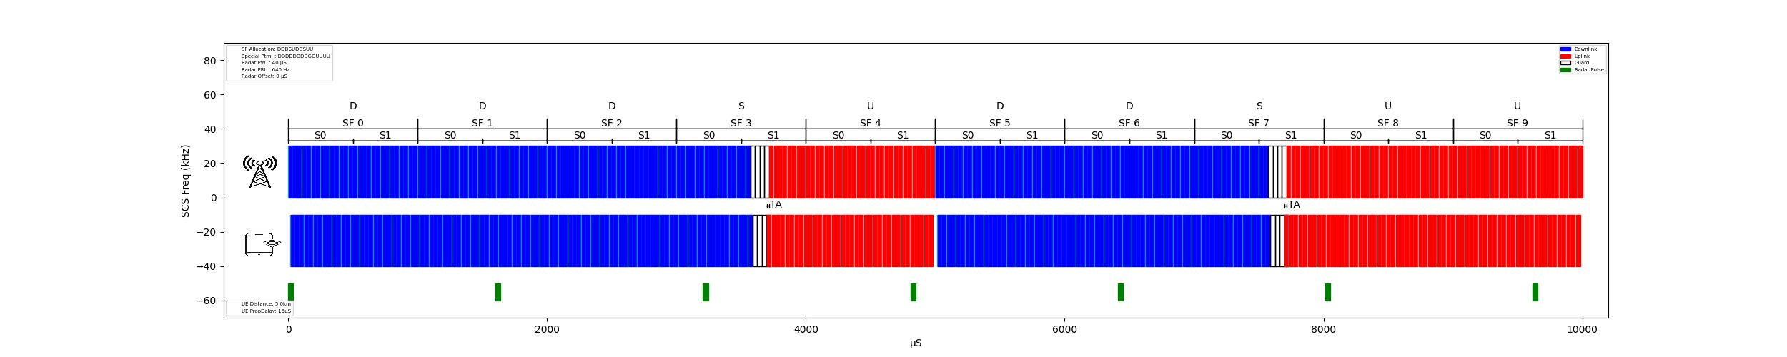
A python script to help see the problem space
https://github.com/macclab-stevens/5GTDD-Radar-Visualizer

Slide 7
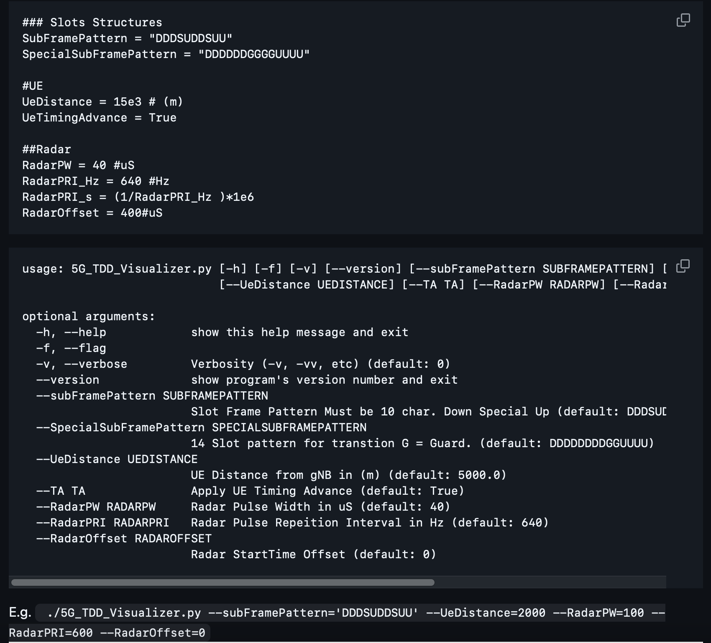
Made for customization!
https://github.com/macclab-stevens/5GTDD-Radar-Visualizer

Slide 8
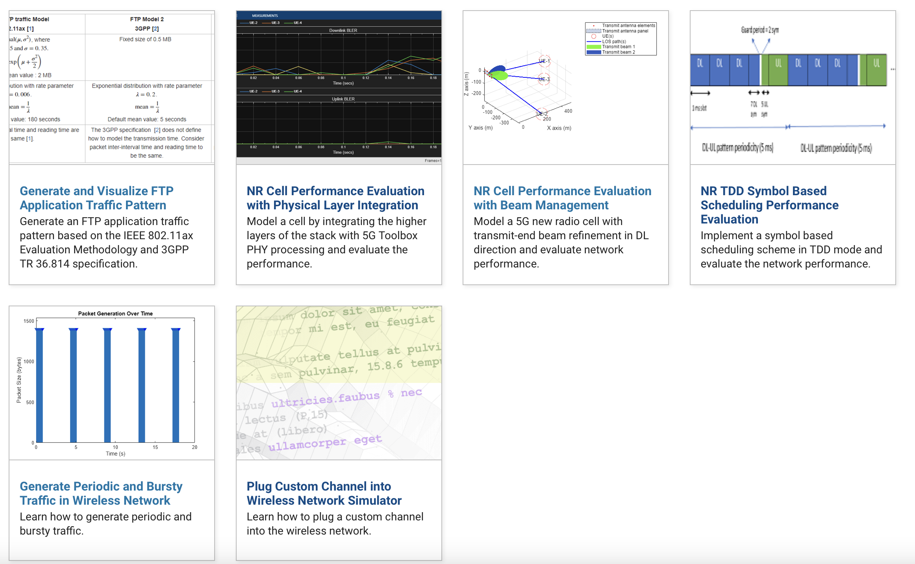
… There’s a model for that
Lots of examples on matlab!
Hard to chose the right one!

Slide 9
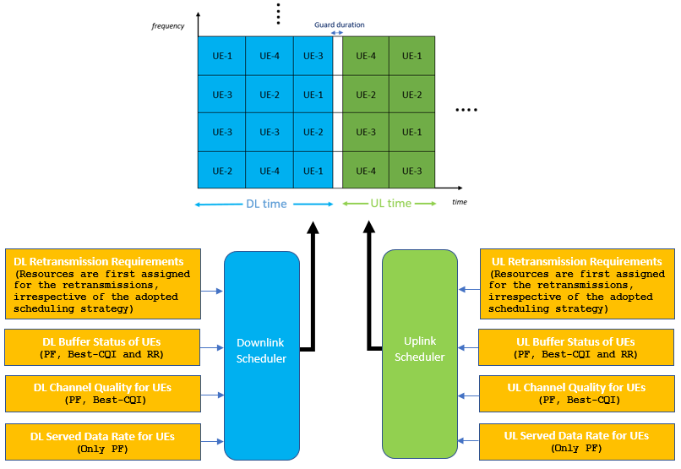
What’s in the example model?
Symbol Scheduling (TTI)
Types of Scheduling (RR & PF)
Multiple UEs (Users)
UEs at Various Distances
UEs with various data rate requirements
UE Results

Slide 10
What IS NOT in the model
Radar interference introduction
Channel Models
Visualization tool(s)
Enhanced logging and results anlaysis

Slide 11
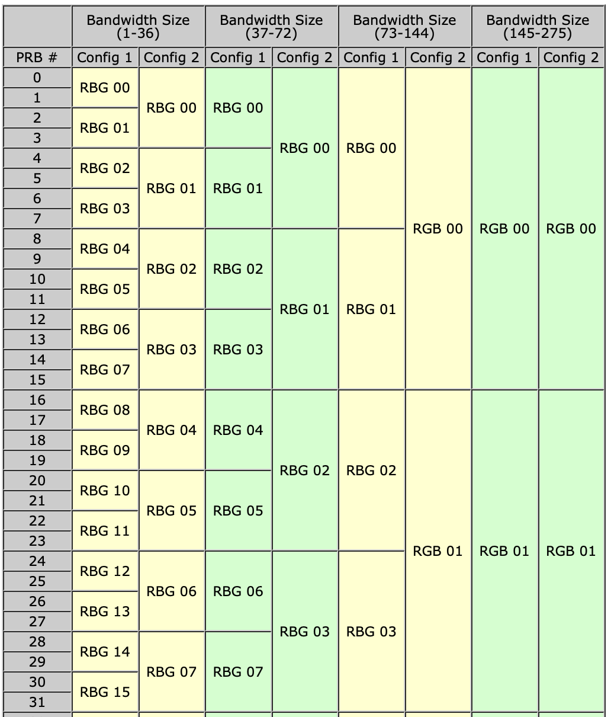
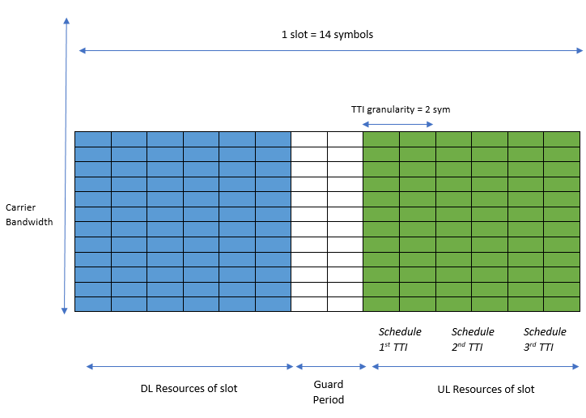
How does radar and 5G Collide!?
They Collide in “Blocks”.
Block are individual transmission groupings that are allocated in RBGs and TTI Groupings:

Slide 12
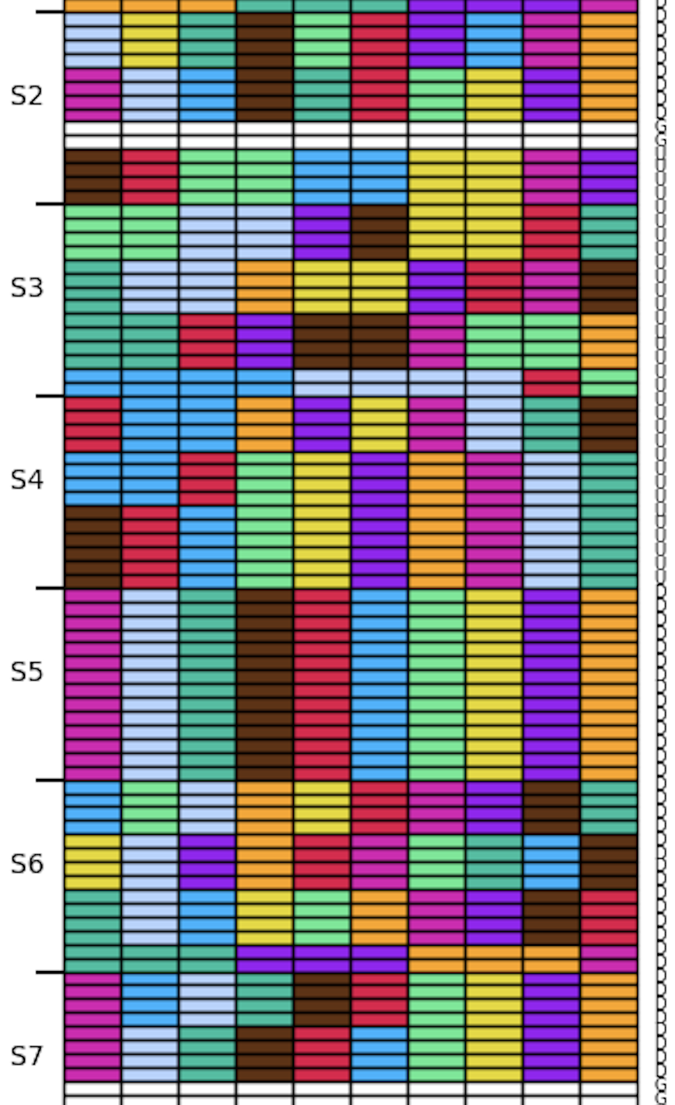
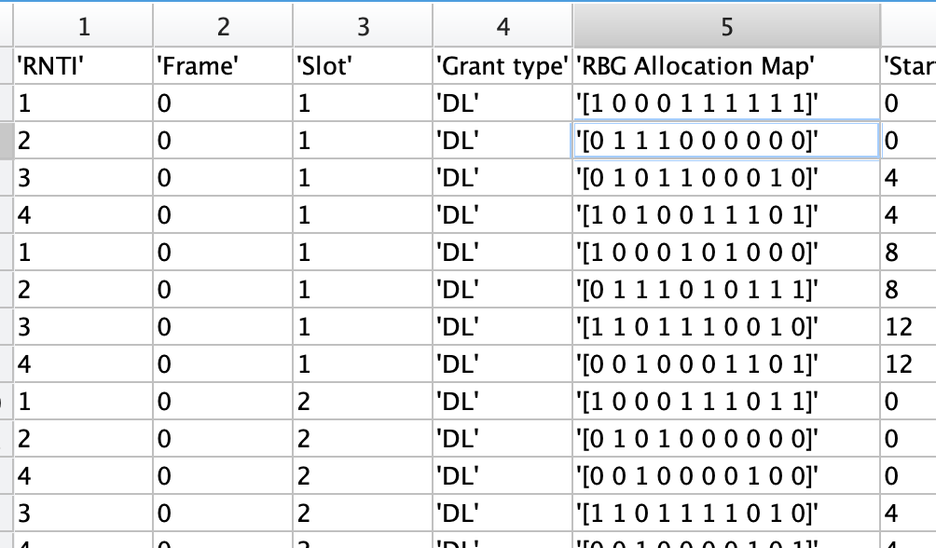
How can we better view the UE allocations? From logs to Graphs!

Slide 13
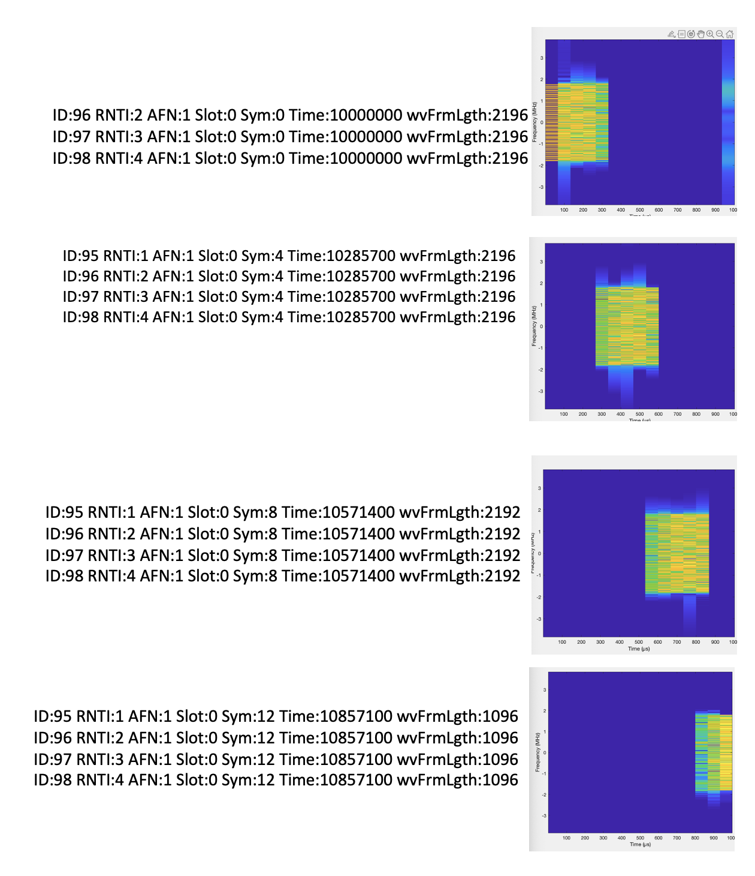
What do 5G Resources look like in the model (Spectrum Perspective)?

Slide 14
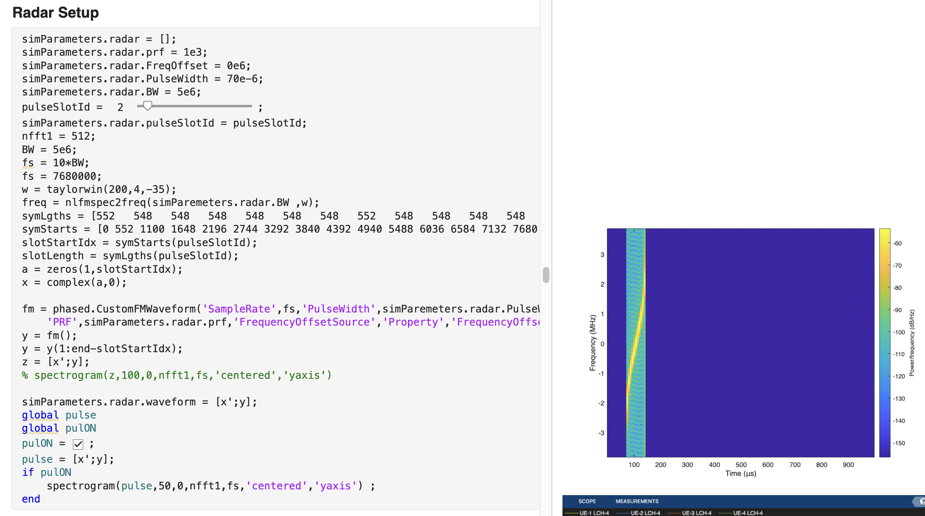
Adding some Pulse Interference (Radar)

Slide 15
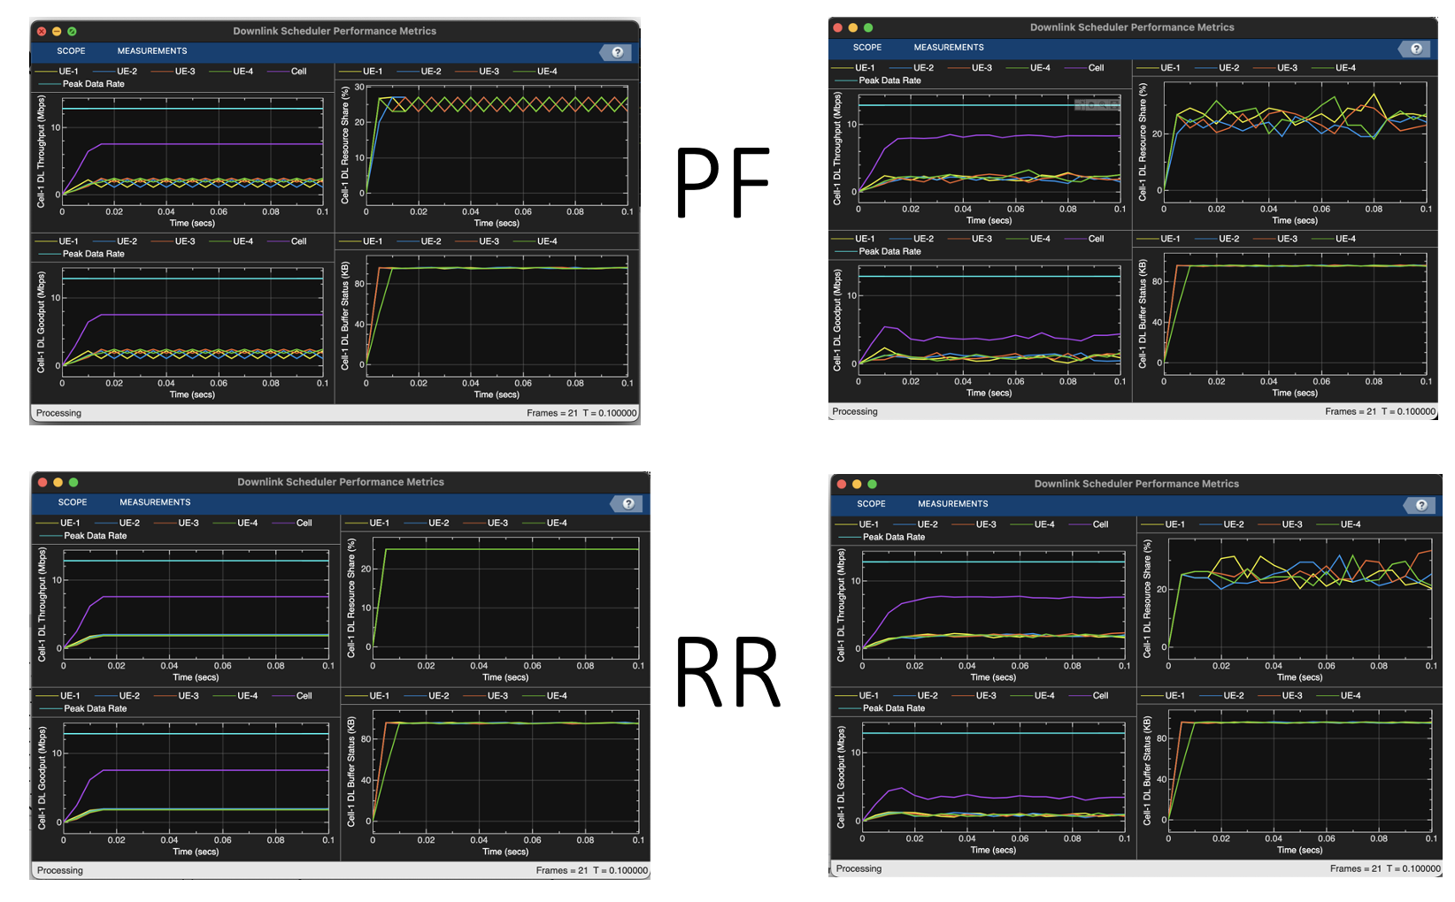
What does “Interference” look like over time?

Slide 16
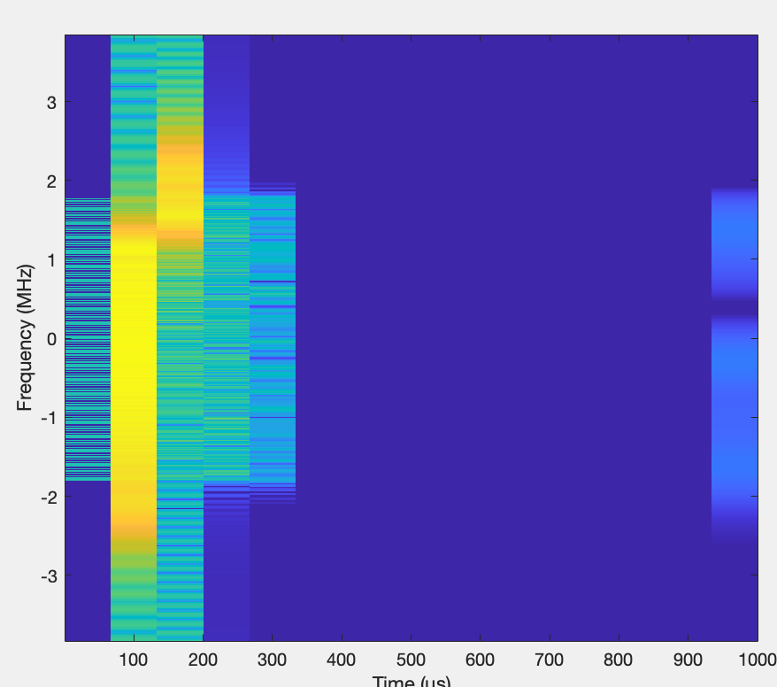
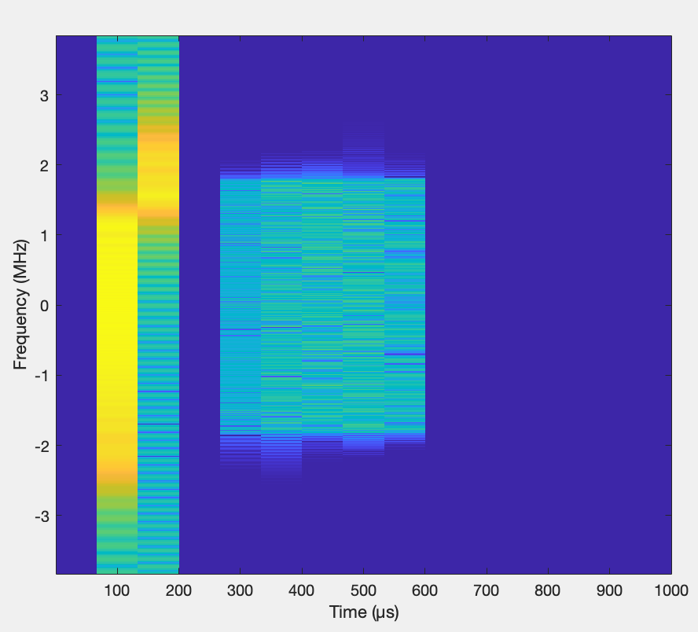
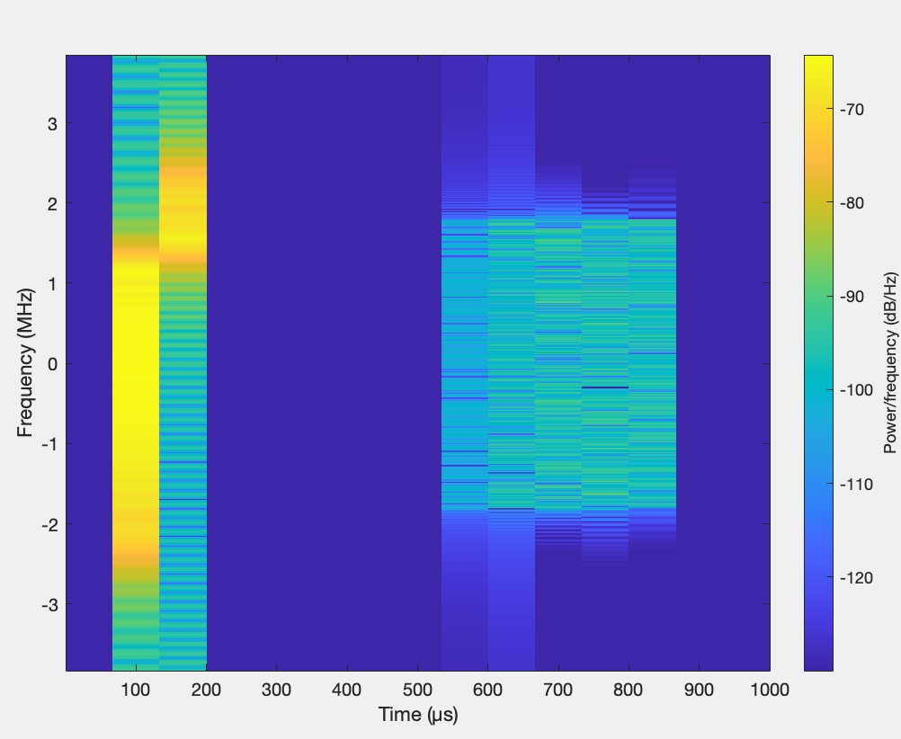
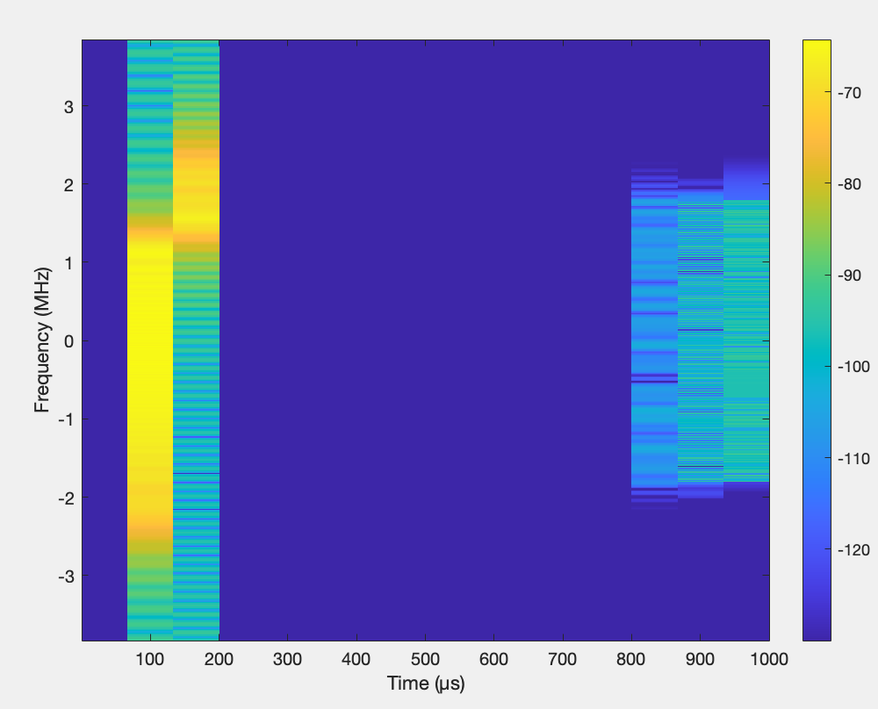
Spectrum Pulses overlapping:

Slide 17
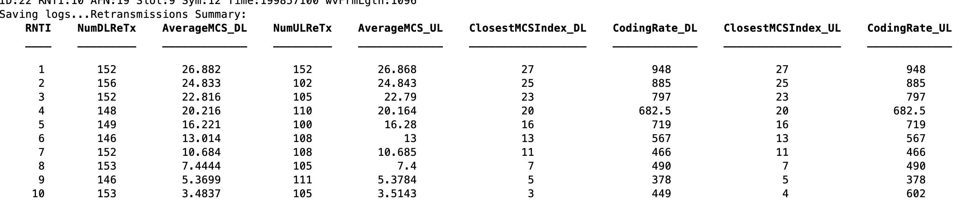
What can be Measured as interference?

Slide 18
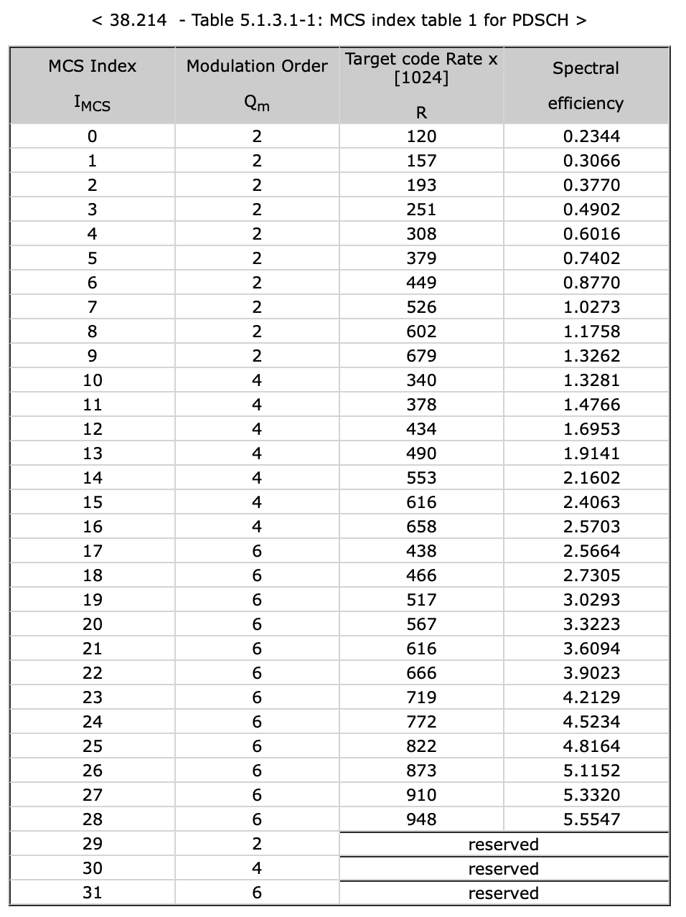
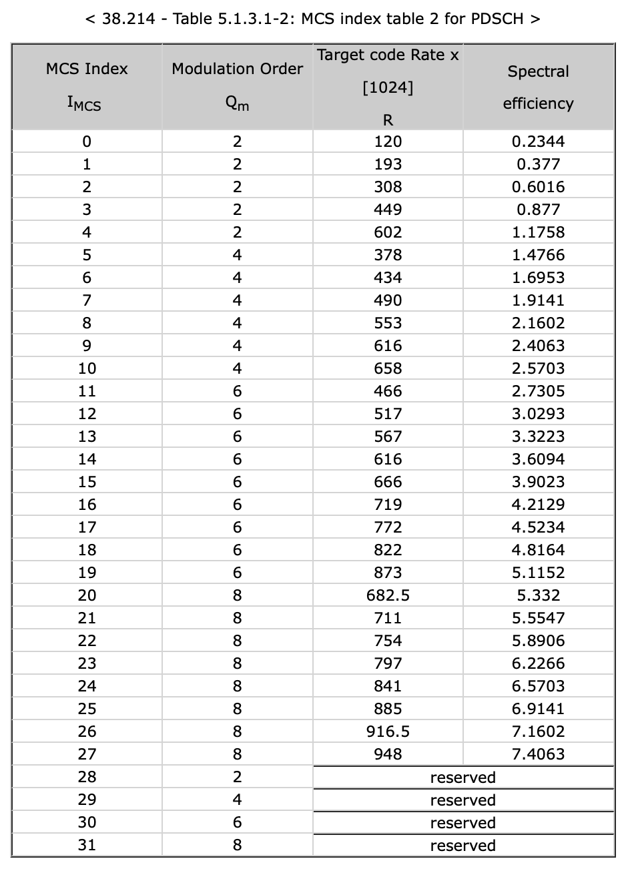
What is MCS and LA in 5G?

Slide 19
Adventures and Questions?
What does changing the TTI interval do?
How does the Pulse Width Matter? (How many symbols it overlaps with)?
What is the direct correlation between the block size in RBGs and TTI to the MCS?
Does the MCS table used matter? (Changing Coding Rates Variances?)

